Slide 1
Full Stack Application Development
Server Side: Implementing Web Services
Problems with REST
Problems with REST
Akshaya Ganesan

Slide 2
Problems with REST API Style
Alternatives to REST

Slide 3

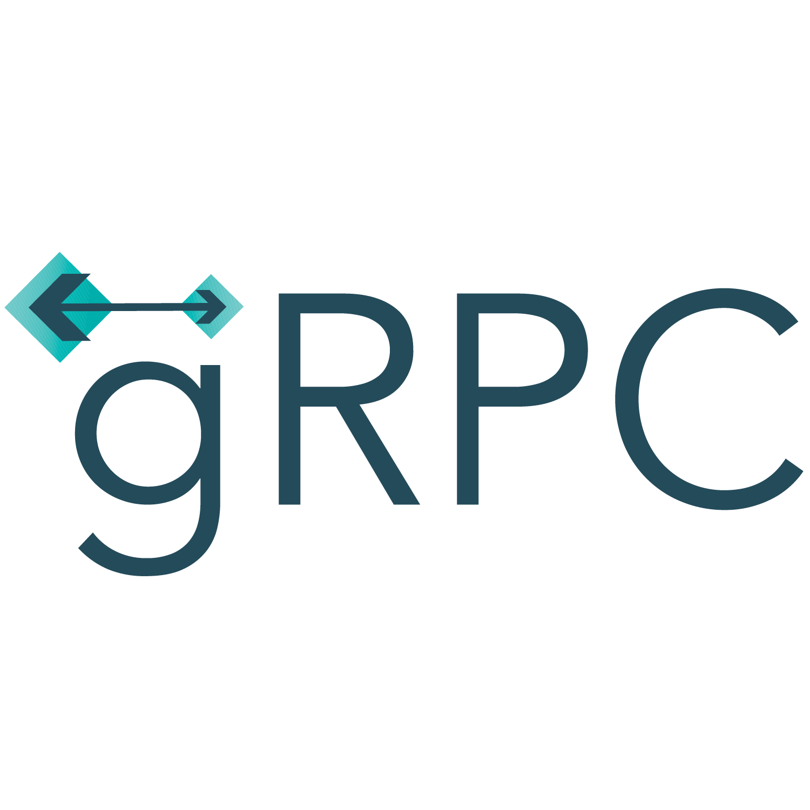

Communication
The communication between the service and client, or the service to service, has drastically evolved over time.
Some of the most commonly used communication techniques are
Other ways include RPC, webhooks, websockets, SOAP, Server sent events.
GraphQL

Slide 4
Conventional RPC
RPC was a popular inter-process communication technique for building client service applications.
With RPC, a client can remotely invoke a function of a method, just like calling a local method.
Popular RPC implementations
Common Object Request Broker Architecture (CORBA).
Java Remote Method Invocation (RMI).
Drawbacks
Complex
Not interoperable

Slide 5
SOAP
Simple Object Access Protocol (SOAP)
SOAP is the standard communication technique in a service-oriented architecture (SOA) to exchange XML-based structured data between services.
Communicates over any underlying communication protocol such as HTTP
Service Broker
Registries
UDDI
WSDL
WSDL
Service Requestor
SOAP
Service Provider

Slide 6
REST
Building applications using the REST architectural style with HTTP and JSON has become the de facto method.
However, RESTful services have not been able to meet the expected modern requirements
With the increasing number of services and
Their complex network interactions.

Slide 7
Limitations of REST
Inefficient text-based message protocols
Lacks strongly typed interfaces between apps
REST architectural style is hard to enforce

Slide 8

Alternatives to REST
GraphQL

Slide 9
Evolution of communication styles
Problems with REST API Style
Alternatives to REST

Slide 10
Thank You!

